Slide 1
Artificial Intelligence
Knowledge Representation

Slide 2
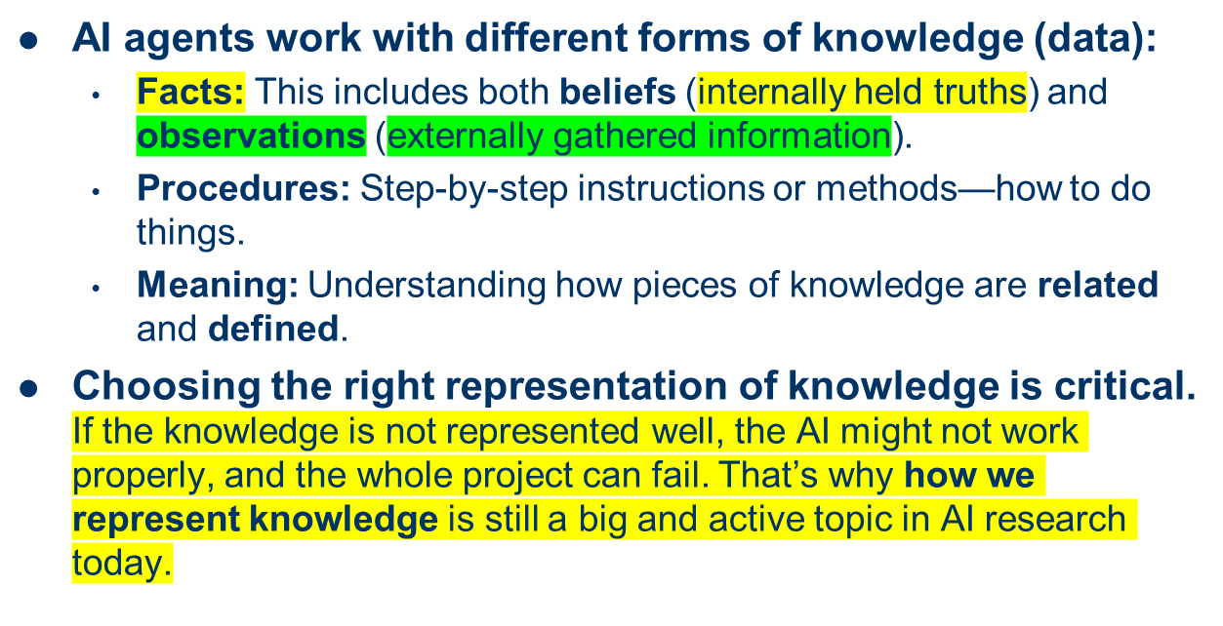
Representation

Slide 3
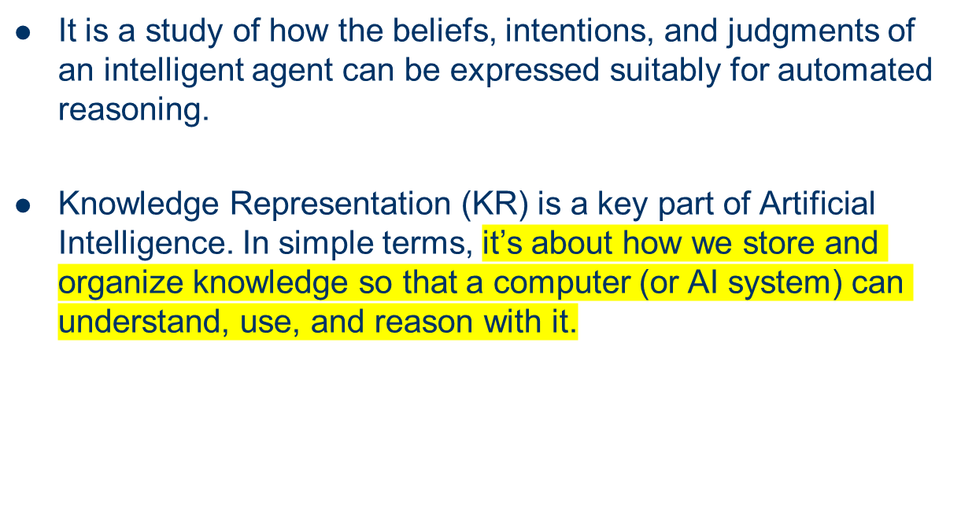
What is Knowledge Representation?
A method of encoding information about the world in a way that a computer system can understand and use to solve problem.

Slide 4
Some General Representations
Logical Representations
Production Rules
Semantic Networks
Frame representation

Slide 5
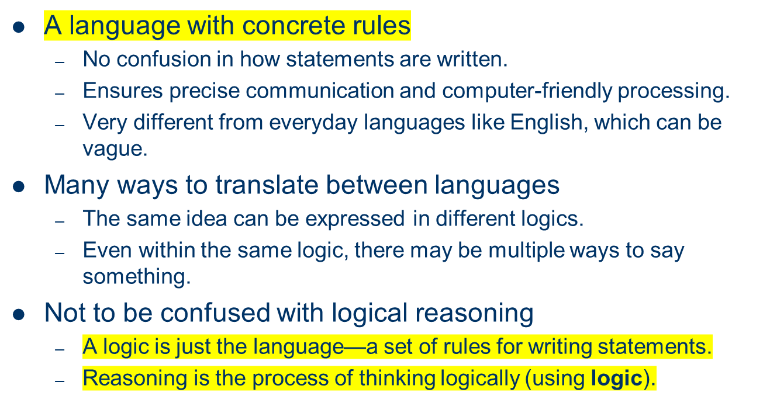
What is a Logic?

Slide 6
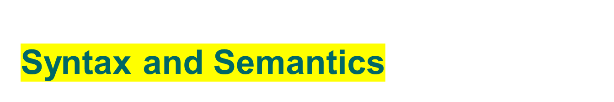
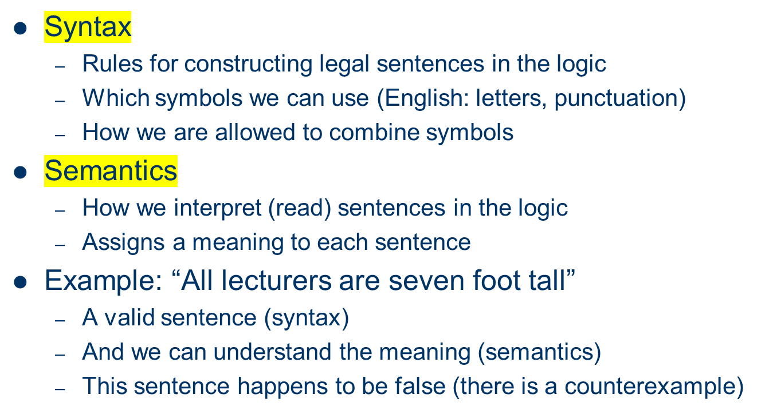

Slide 7
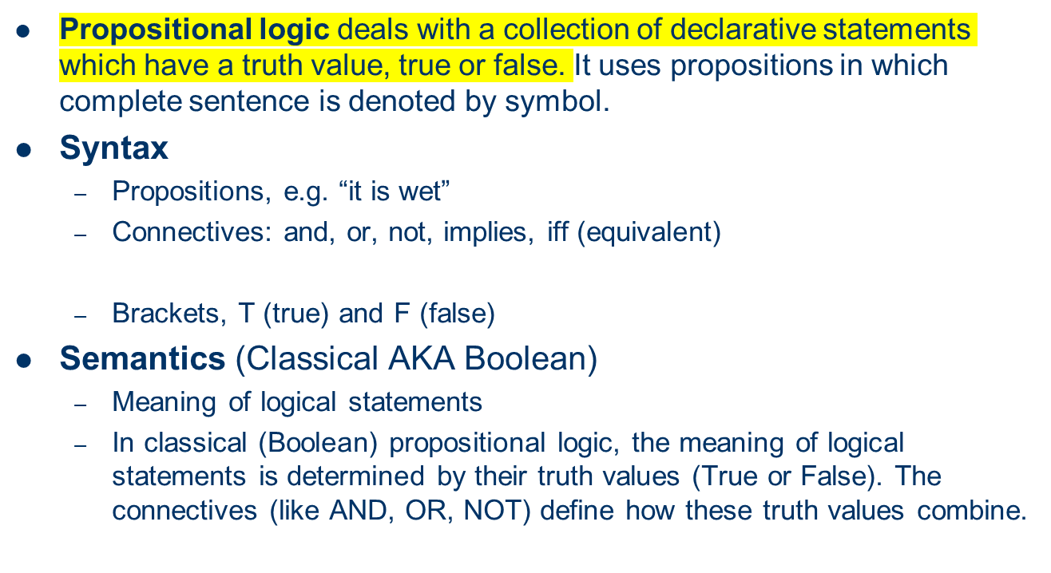

Propositional Logic

Slide 8
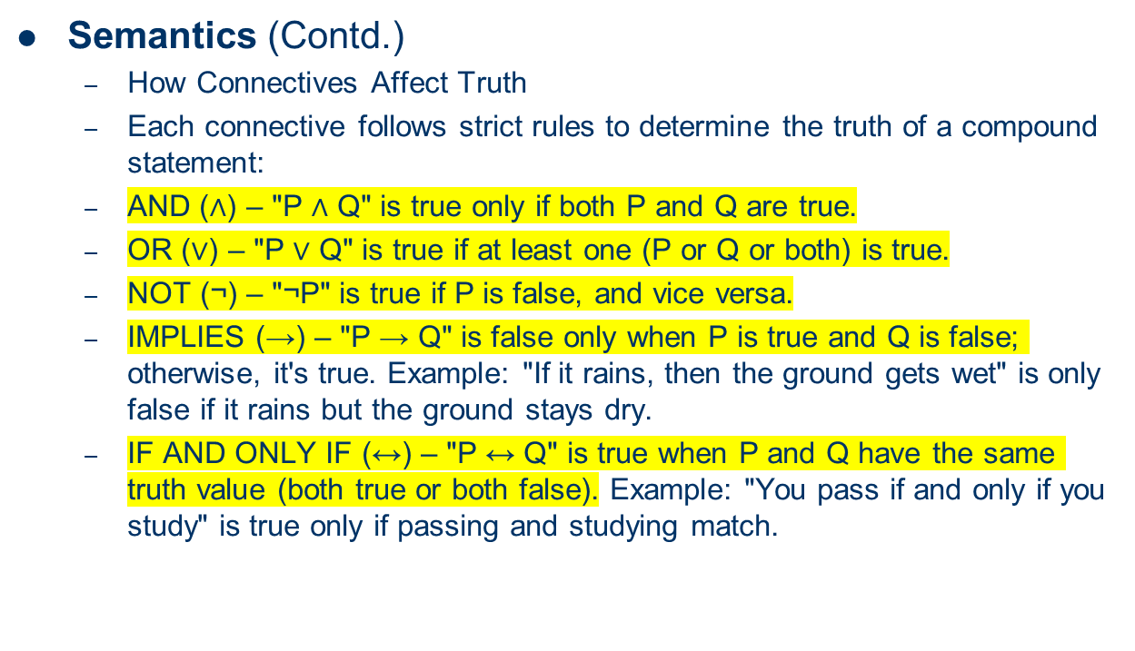
Propositional Logic

Slide 9
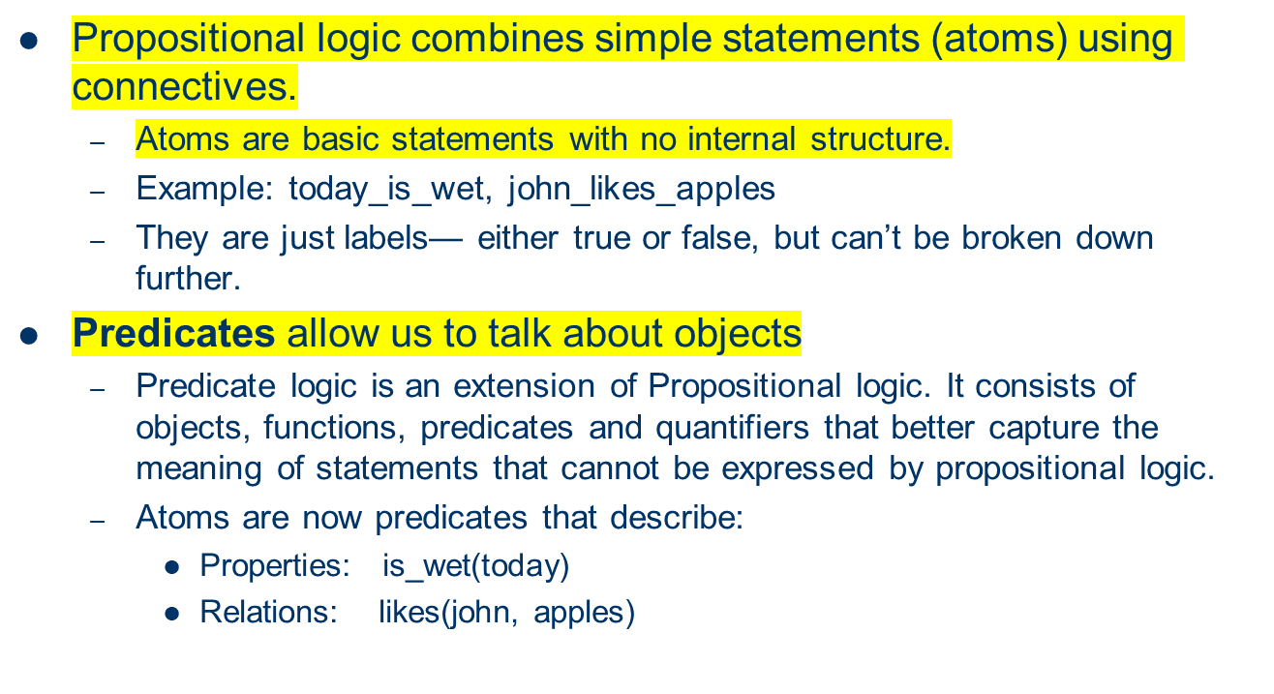
Predicate Logic
In propositional logic, we can only represent the fact, which are either true or false. It is not sufficient to represent the complex sentences or natural language statements. To remove the limitation we use Predicate logic.

Slide 10
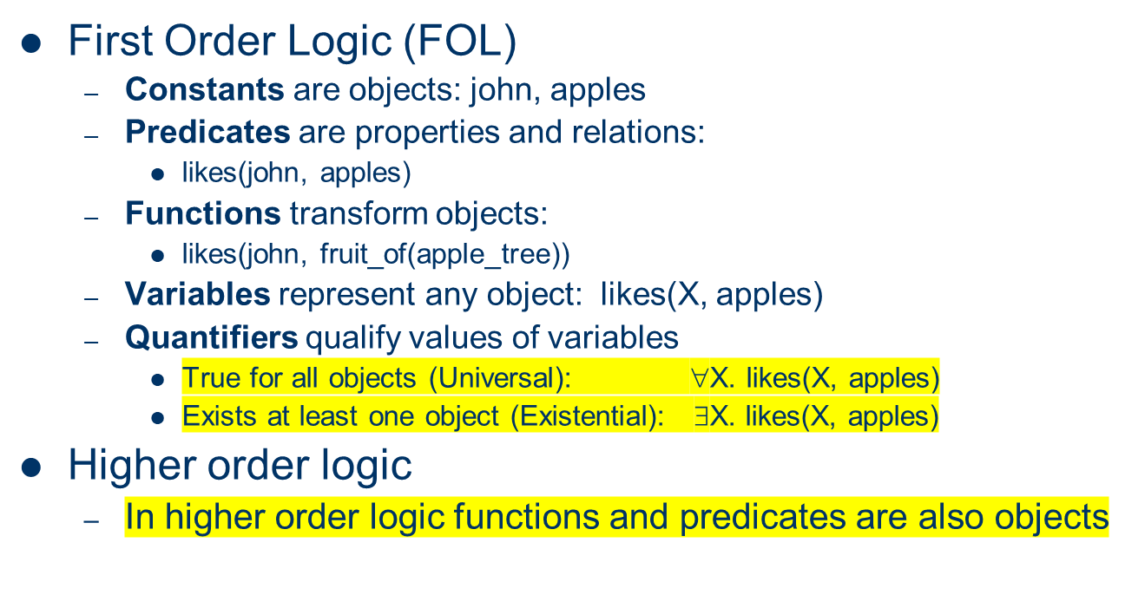
Predicate Logic

Slide 11
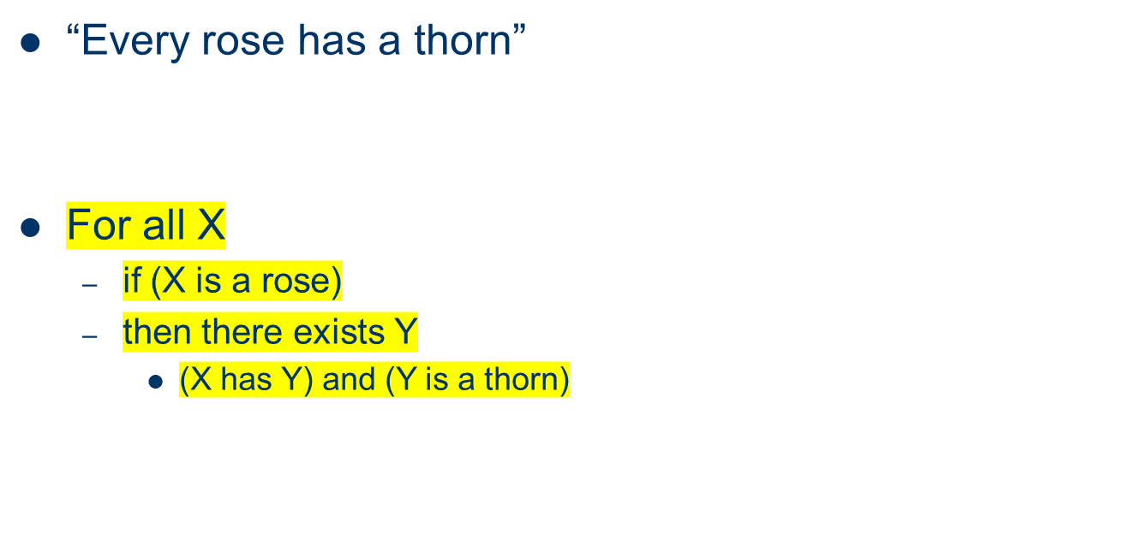
Example: FOL Sentence(First Order Predicate Logic Sentence)

Slide 12
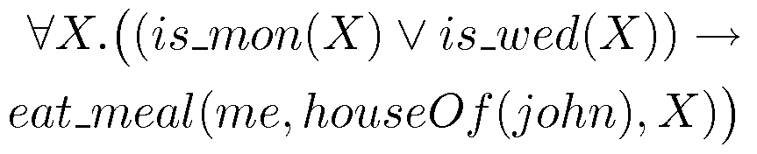
Example: FOL Sentence
“On Mondays and Wednesdays I go to John’s house for dinner”
Note the change from “and” to “or”
  Translating is problematic

Slide 13
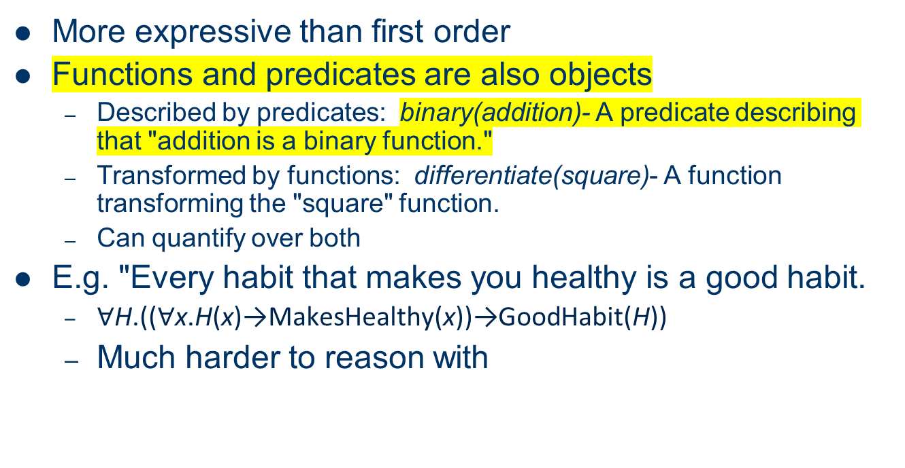

Higher Order Logic
Ex: Define red function as having zero at 17.

Slide 14
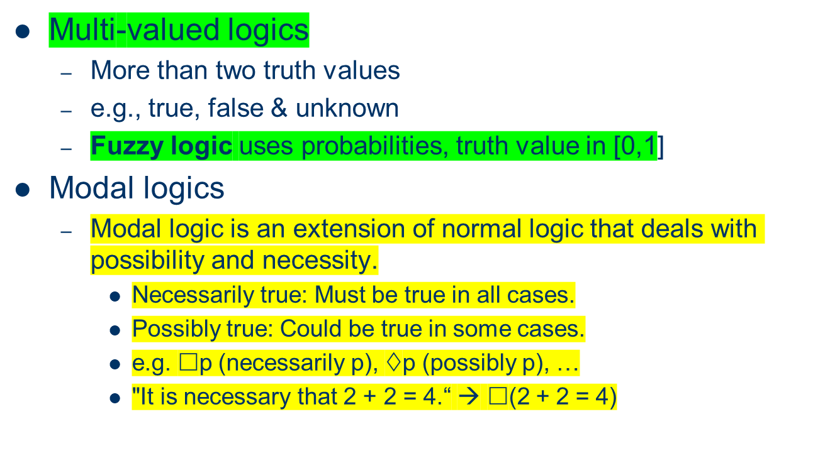
Beyond True and False
Fuzzy logic is one kind of multi-valued logics

Slide 15
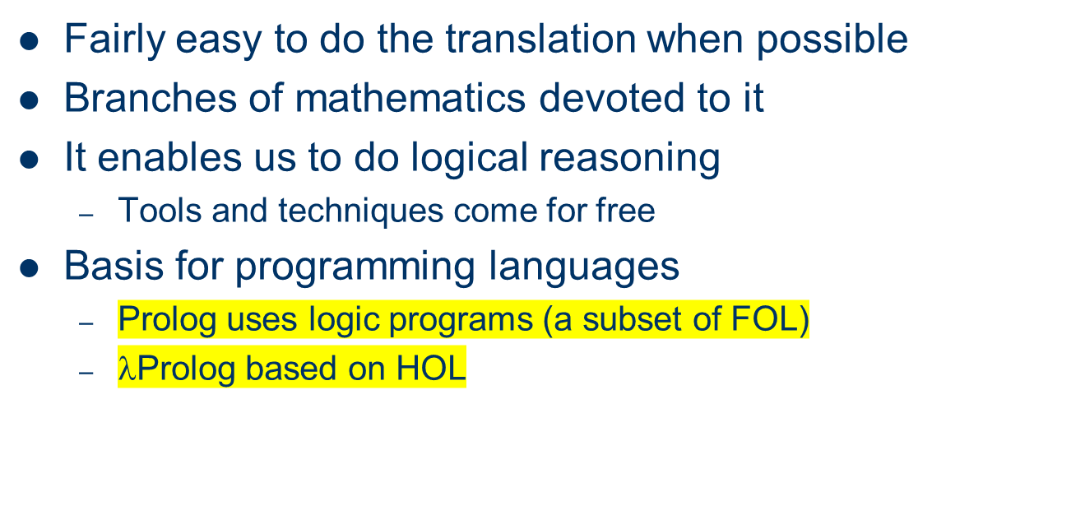
Logic is a Good Representation

Slide 16
Non-Logical Representations?
Logic representations have restrictions and can be hard to work with
  Logic representations require exact, unambiguous input and assume all knowledge is complete and consistent. This makes them hard to work with in real-world situations where information is often uncertain, vague, or incomplete
  Many AI researchers searched for better representations

Slide 17
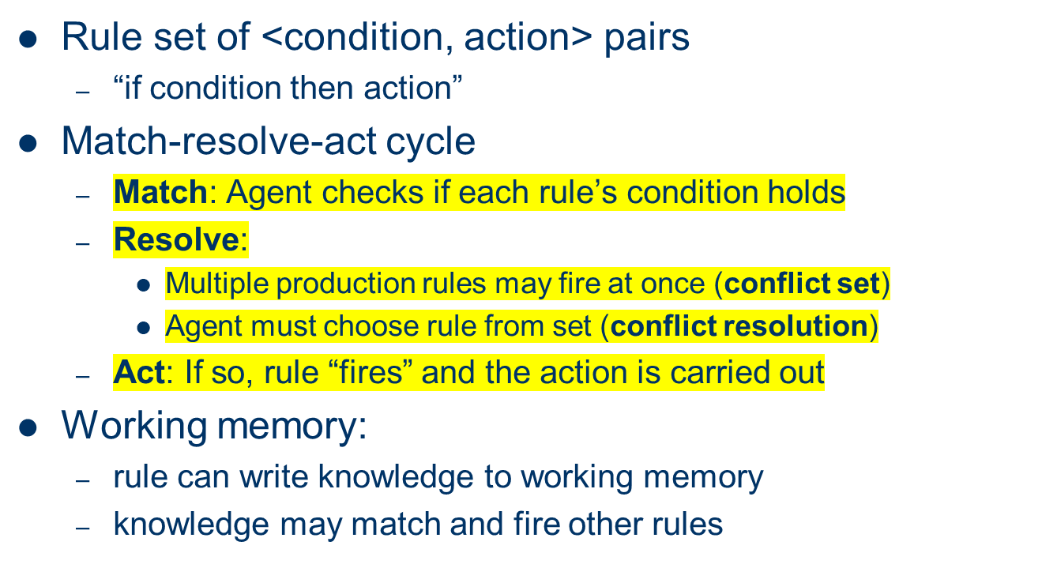
Production Rules

Slide 18
Production Rules Example
IF (at bus stop AND bus arrives) THEN action(get on the bus)
IF (on bus AND not paid AND have oyster card) THEN action(pay with oyster) AND add(paid)
IF (on bus AND paid AND empty seat) THEN sit down
conditions and actions must be clearly defined
  can easily be expressed in first order logic!

Slide 19
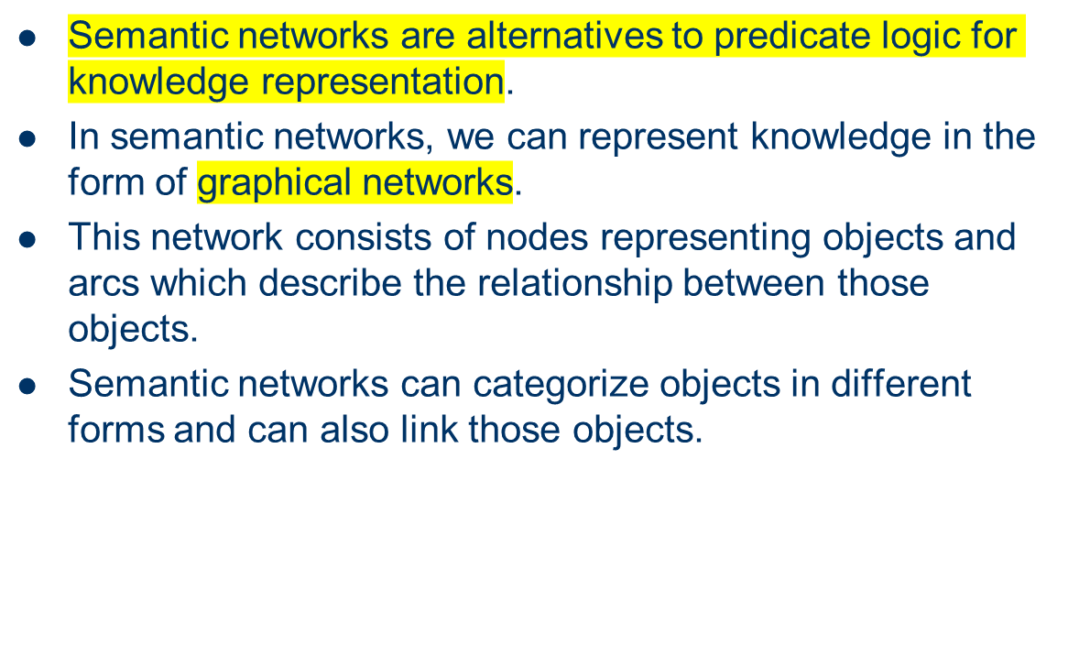
Semantic Networks
We represent our knowledge in the form of graphical nodes.

Slide 20
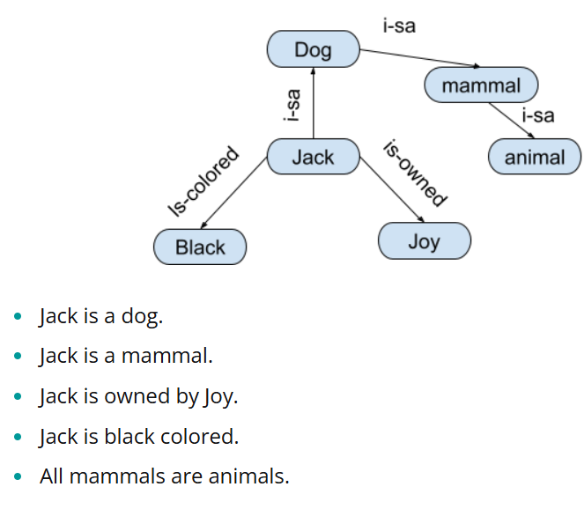
Semantic Networks
Example:

Slide 21
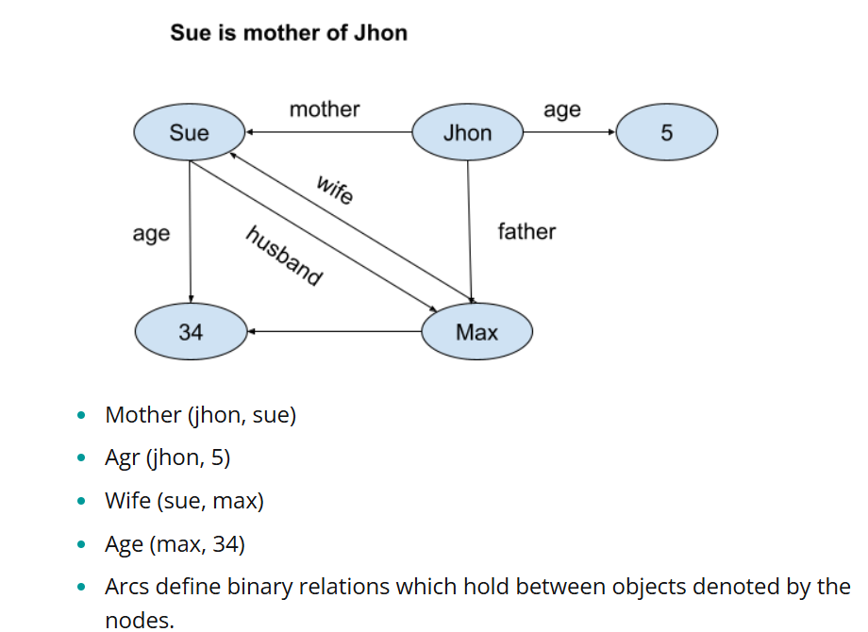


Semantic Networks
Example:

Slide 22
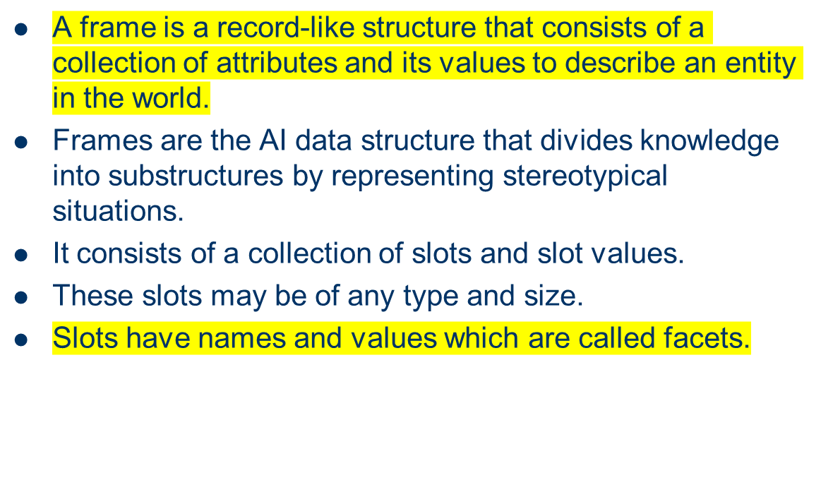
Frame Representations

Slide 23
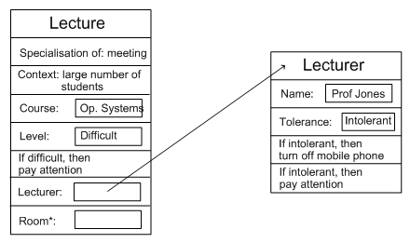
Example: Frame Representation

Slide 24
Flexibility in Frames
Slots in a frame can contain
  Information for choosing a frame in a situation
  Relationships between this and other frames
  Procedures to carry out after various slots filled
  Default information to use where input is missing
  Blank slots: left blank unless required for a task
  Other frames, which gives a hierarchy
Can also be expressed in first order logic

Slide 25
Representation & Logic
AI wanted “non-logical representations”
  Production rules
  Semantic networks
    Conceptual graphs, frames
But all can be expressed in first order logic!
Best of both worlds
  Logical reading ensures representation well-defined
  Representations specialised for applications
  Can make reasoning easier, more intuitive

